Slide 1
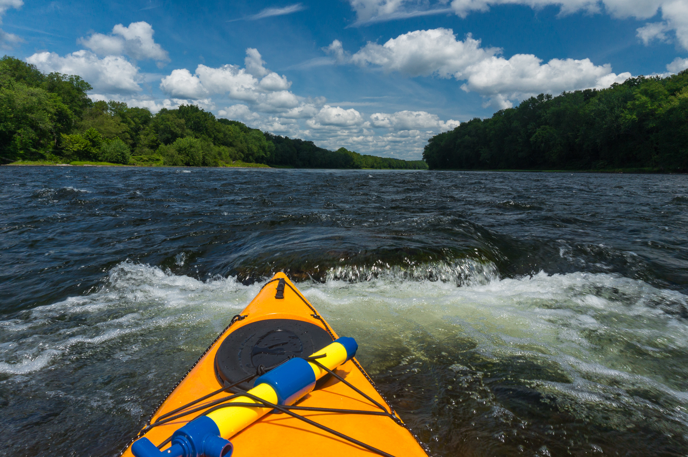
Amplifying Individual Voices for a Collective Goal
Sandra Meola
Director
Coalition for the Delaware River Watershed

Slide 2
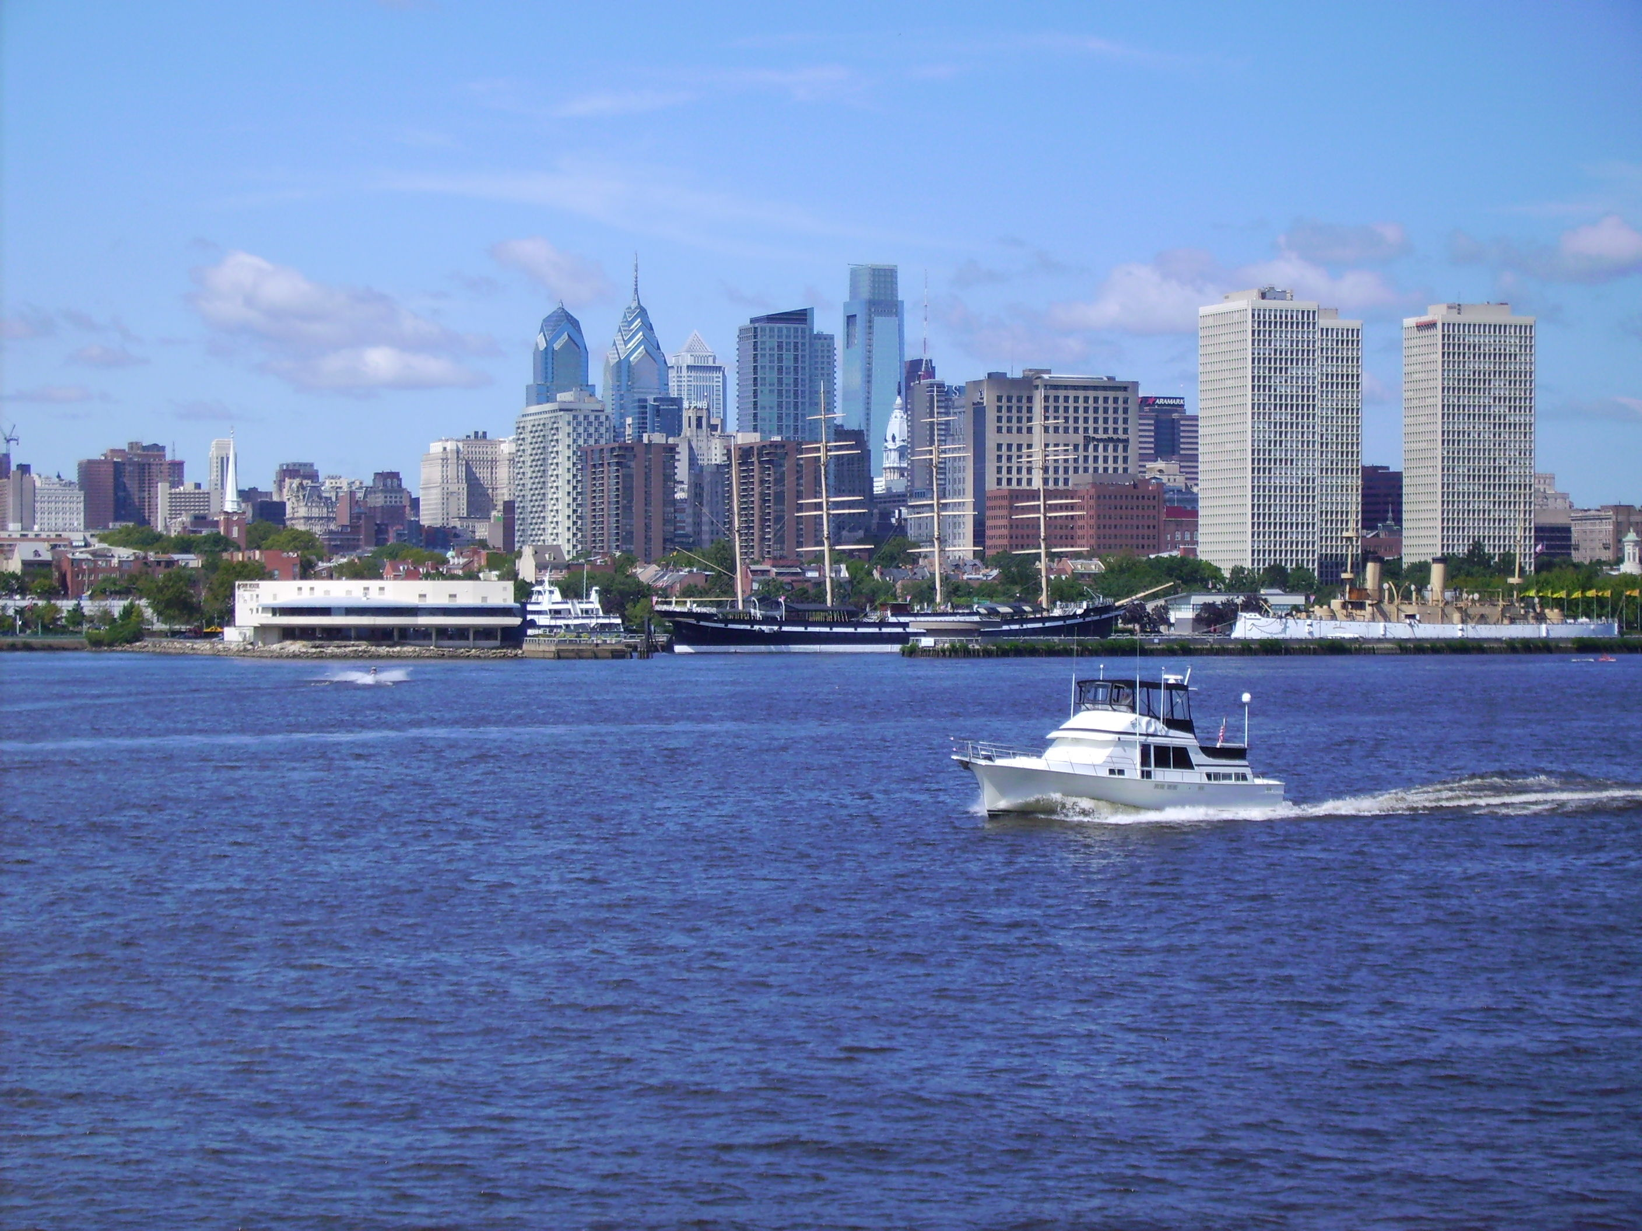
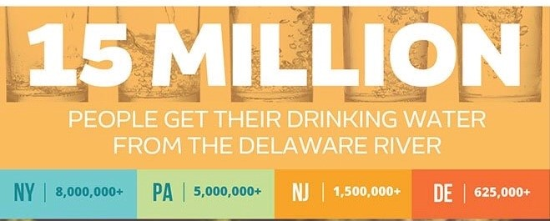
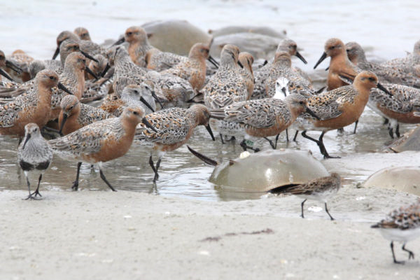
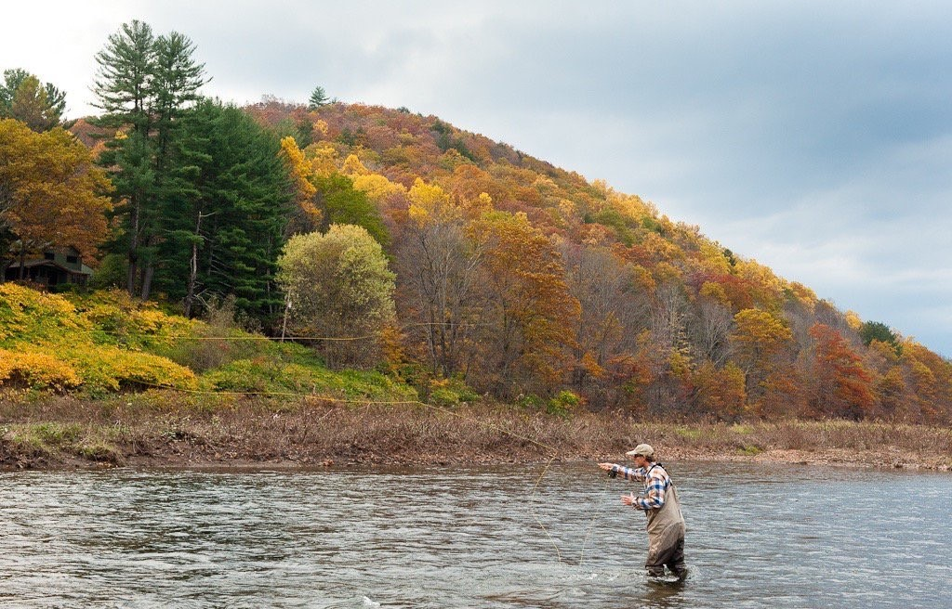
The Delaware River Watershed

Slide 3
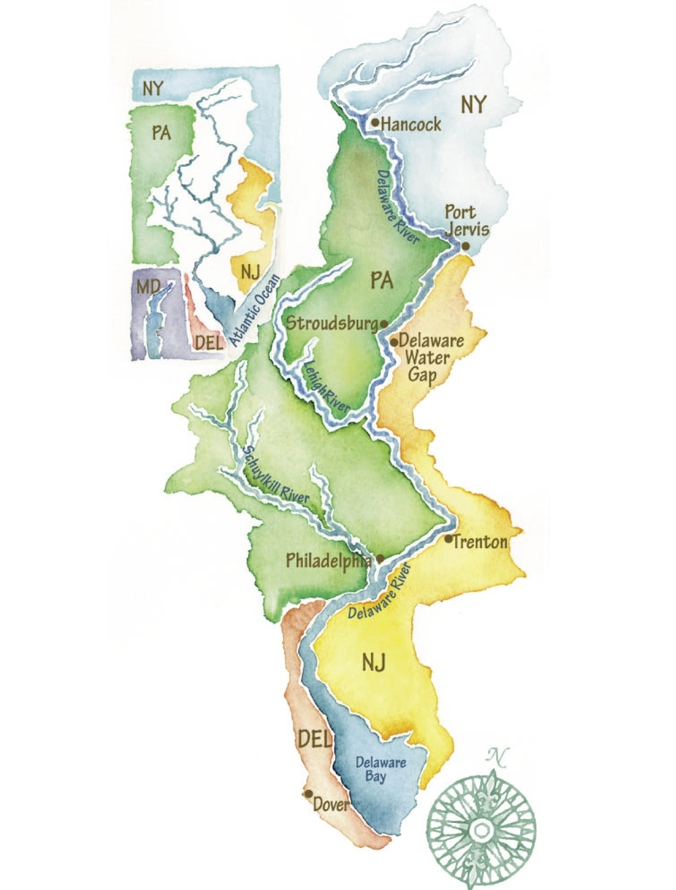
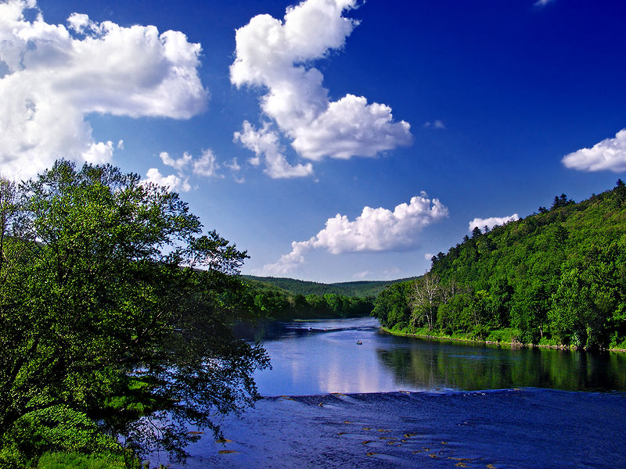
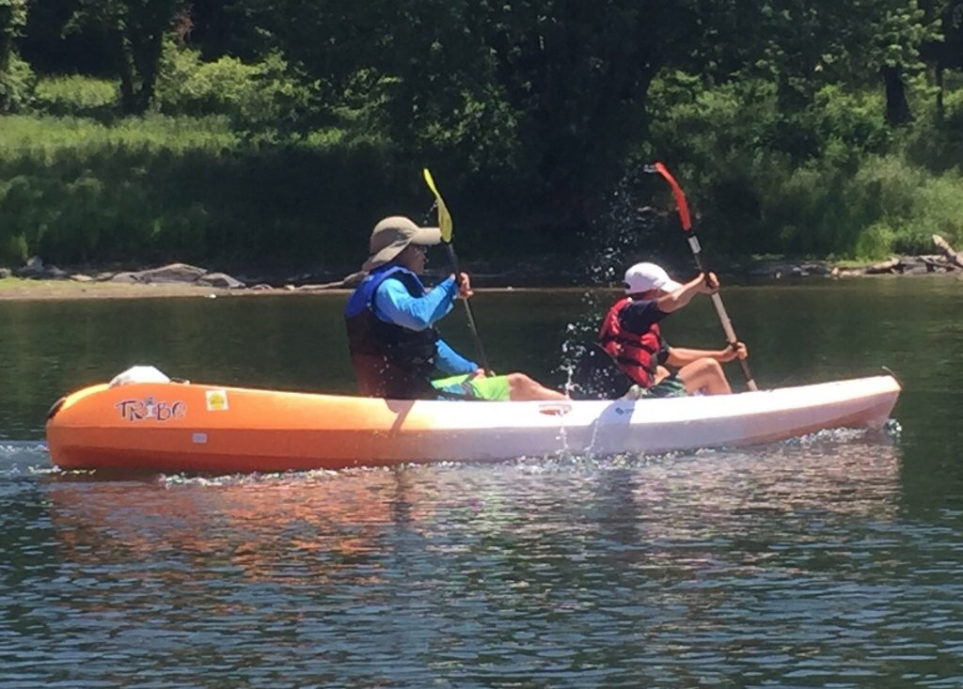

Slide 4
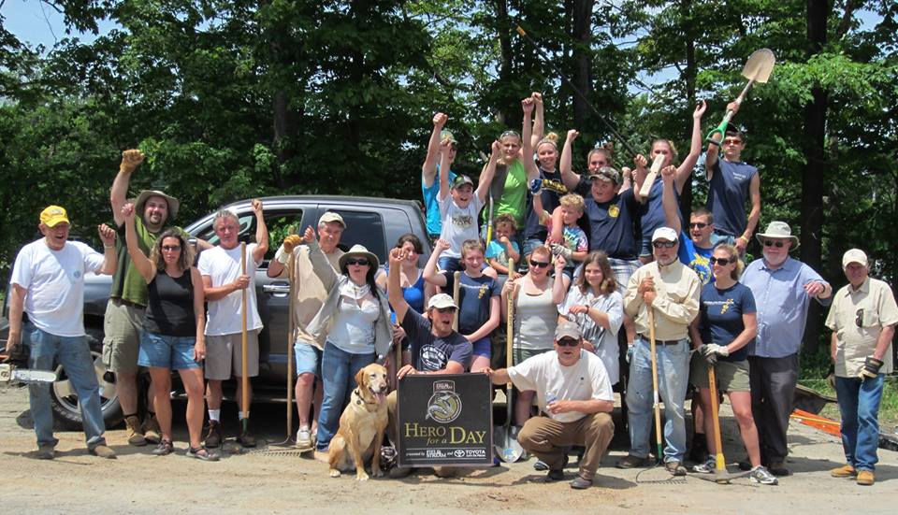
Coalition for the Delaware River Watershed (CDRW)
Membership
Watershed Associations • Recreation & Outdoor Interests
• Conservation Organizations • National Advocacy Groups • Land Conservancies • Education Centers

Slide 5

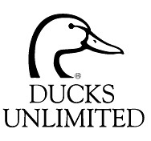




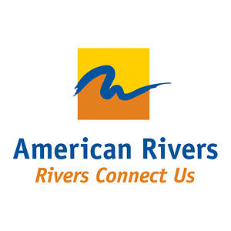

CDRW’s Mission Statement
To unite organizations and enhance
their capacity to effectively advocate for protecting and restoring the Delaware River Basin by coordinating communications, messages, and actions and fostering the accountability for success at the federal,
state, and local levels.

Slide 6
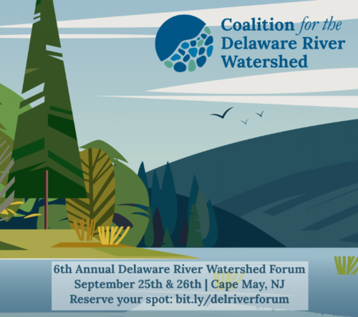
Activities
Legislative outreach & sign-on letters
Communication toolkits
Building relationships
Networking opportunities
  Delaware River Watershed Forum

Slide 7
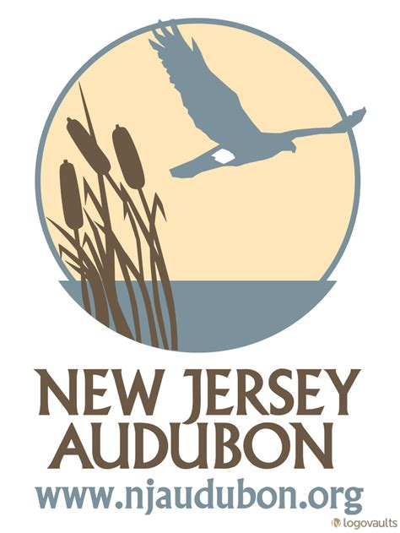


CDRW Founding and History

Slide 8
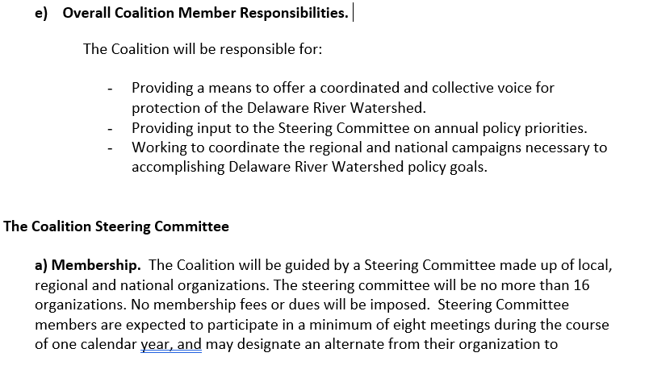
Governance Structure
Membership criteria
Steering Committee
Co-chairs
Creating committees

Slide 9
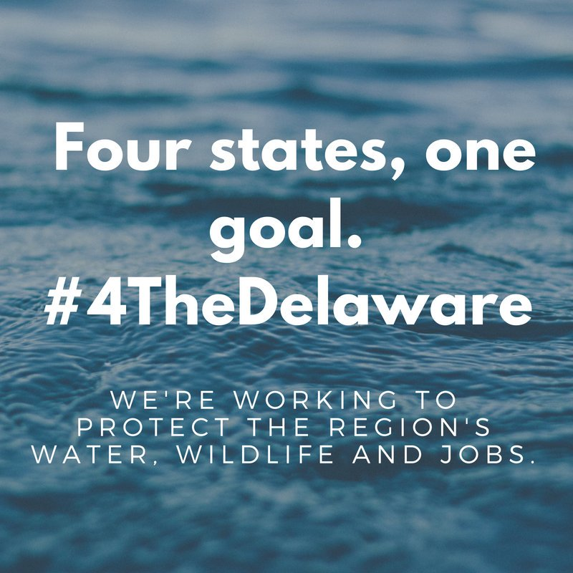
Growing Pains
Territory wrestling and subject matter tensions were combatted with trust building, transparency, and open communication toward reaching a shared vision.
Annual Fly-in – Setting goals and effectively reaching them are 2 different things!

Slide 10
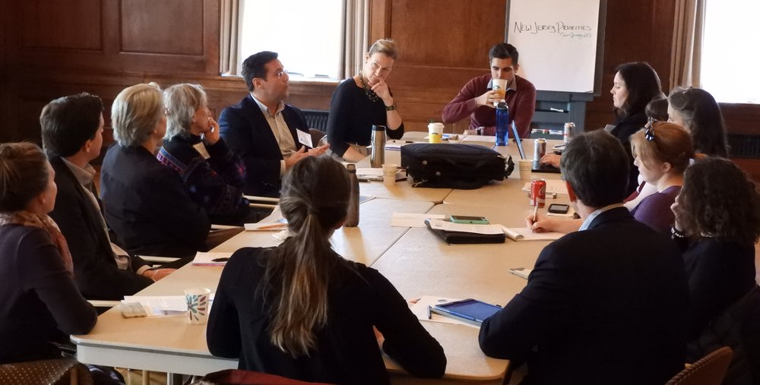
Priority Setting Structure
Big tent ideas
Buy-in from all members
Every member has skin in the game to forward a policy priority
Not biting more off than can be chewed
Joint actions result in the achievement of priority outcomes beyond the reach of any individual partner

Slide 11
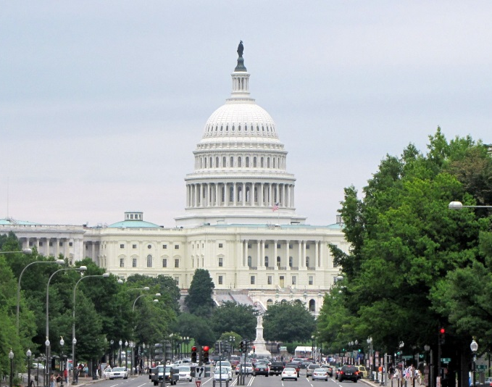
CDRW’s 2018 Priorities
1. Watershed- Wide Planning
Developing a framework and structure for DRBRP
Host annual Delaware River Watershed Forum
Governor’s Campaign
Support the implementation for the Flexible Flow Management Plan
2. Federal Policy and Funding
Delaware River Basin Restoration Program
Partnership Wild and Scenic Program
Land and Water Conservation Fund
Defense of the Clean Water Act and funding
2018 Farm Bill
3. State Leads Program
4. Diversity, Equity, and Inclusion

Slide 12
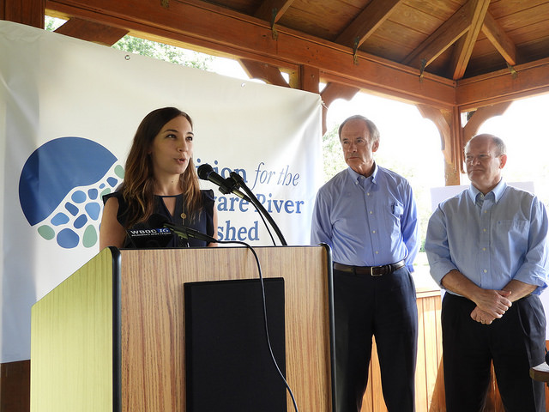
Success Story: Delaware River Basin Conservation Act
  DRBCA Work Group
  Relationships with member and committee staff
  Communications strategy
  Historic federal funding for the Delaware River Watershed!

Slide 13
Lessons Learned: Strong Leadership
“The greatest leader is not necessarily the one who does the greatest things. He [or she!] is the one that gets the people to do the greatest things.”
- Ronald Reagan
Notes:
Aligning many groups and individuals effectively to achieve shared goals requires leaders with strategic vision and effective coalition-building skills

Slide 14
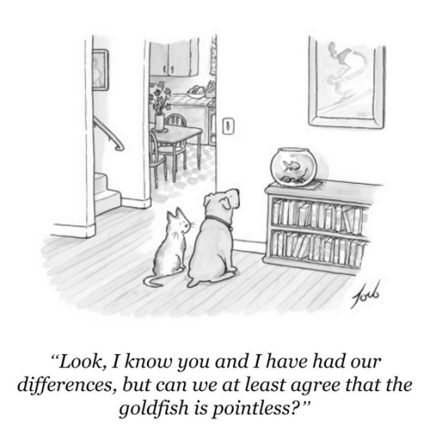
Lessons Learned: Compelling, Shared Goal
Notes:
Clear, focused goals should be articulated that are compelling to the coalition members and require collaboration to achieve.

Slide 15
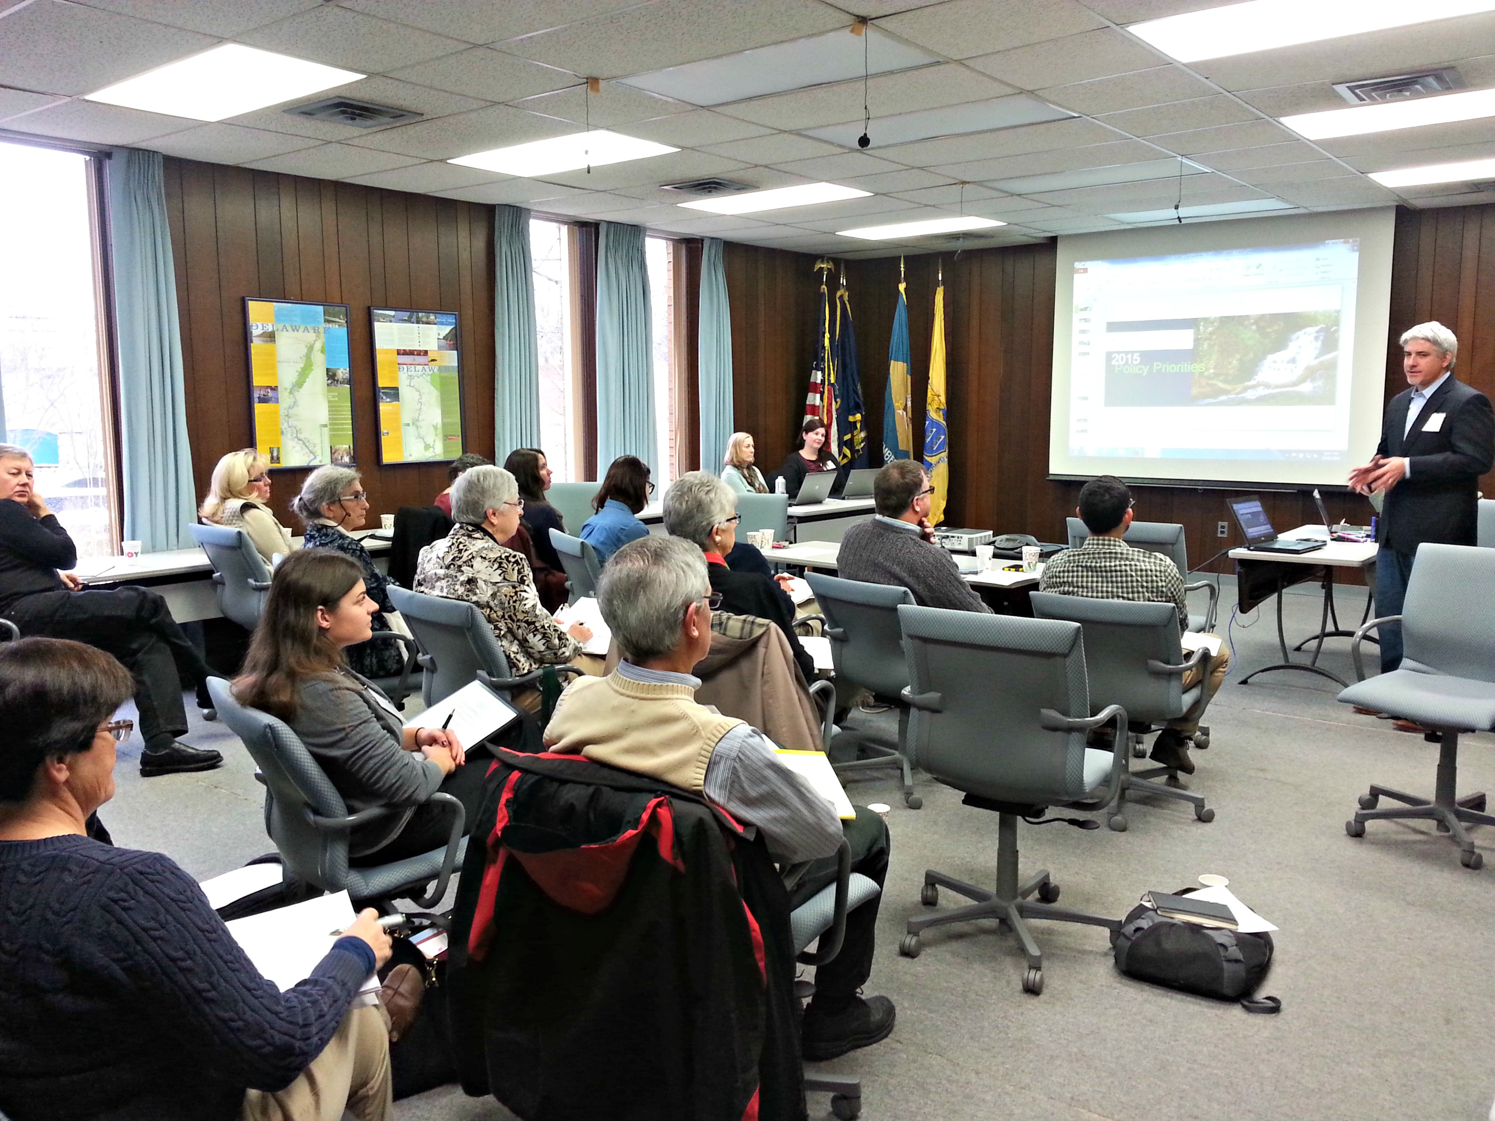
Lessons Learned: Trust, Clear Decision Making
  Staff, Steering Committee, and Workgroup Integration
  Clear priority setting process
  Non-competitive
Notes:
Coalition members must forge good working relationships and trust over time. Having clear decision-making processes and mechanisms to resolve conflicts can help to build trust

Slide 16








Lessons Learned: Diverse Membership
Notes:
Align with diverse interests for greater clout, such as sportsmen, labor, agriculture, real estate, and business communities.

Slide 17
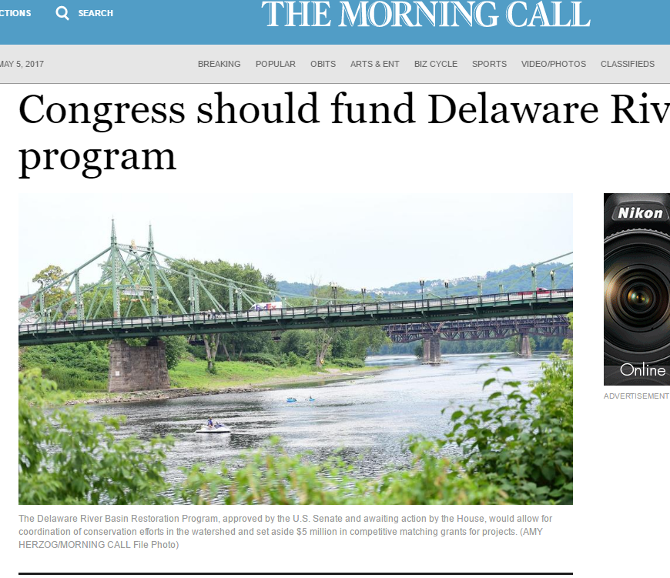
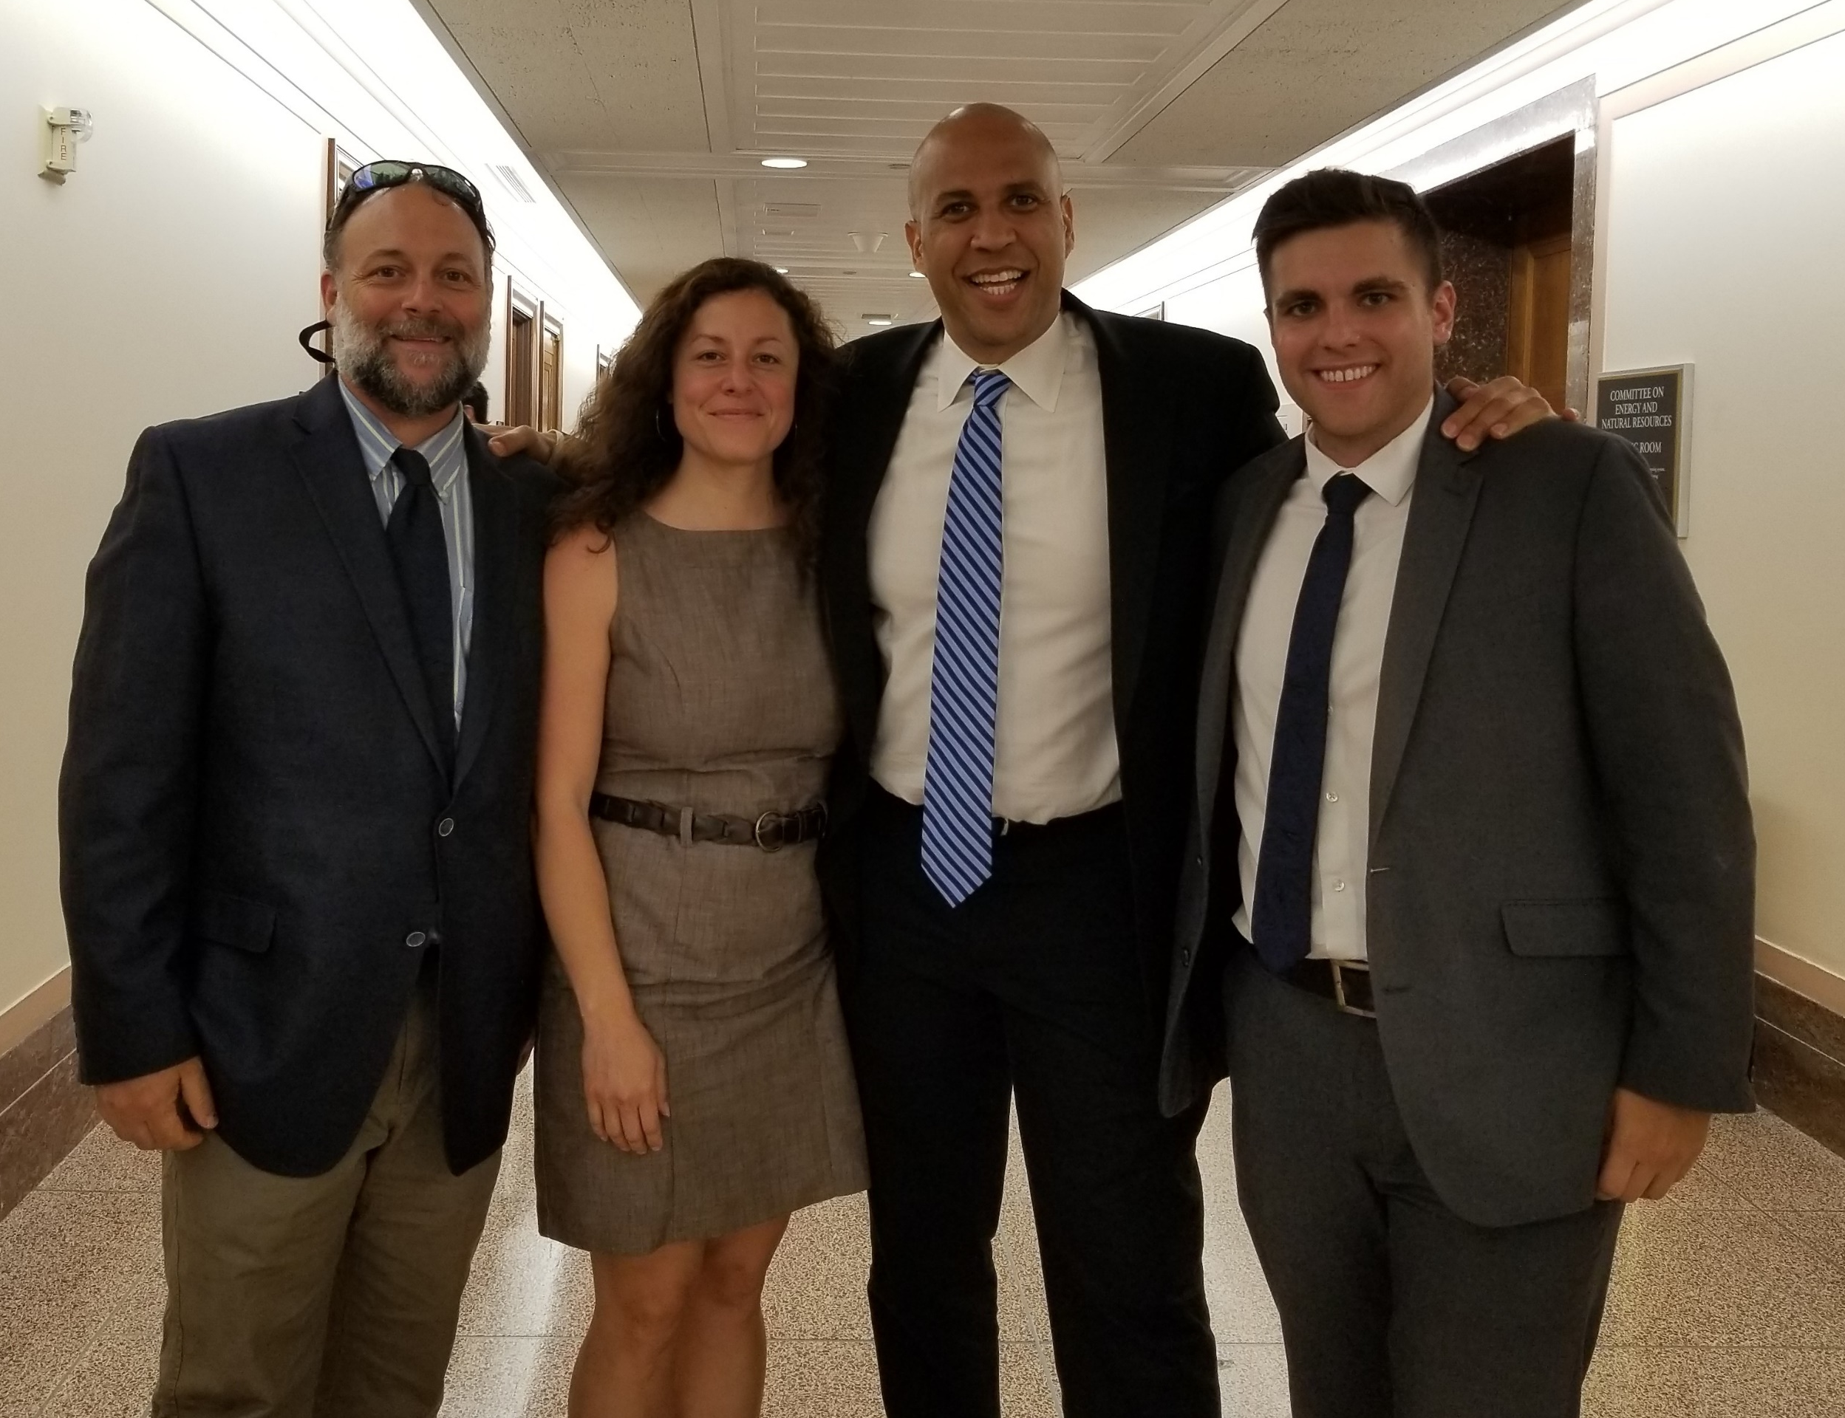
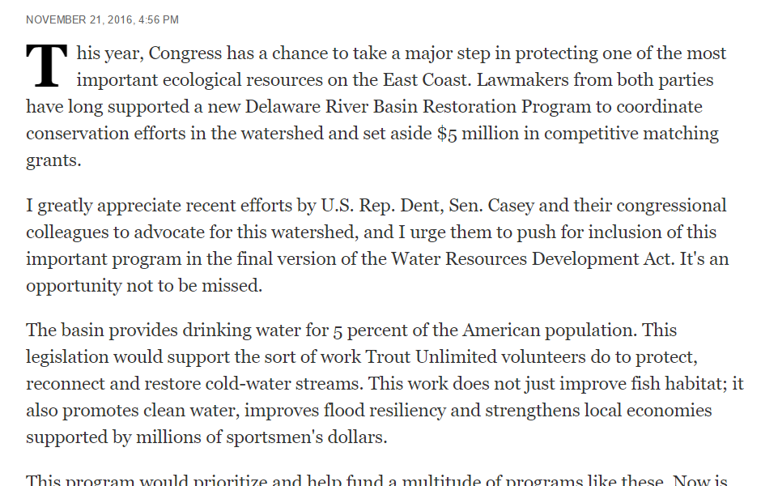
Lessons Learned: Sustained Grassroots/Grasstops Support
Notes:
The ability to mobilize grassroots support and engage bipartisan opinion leaders in support of the coalition’s goals are critical to success.
Efforts must be sustained over time to ensure implementation, especially given economic and fiscal challenges.

Slide 18
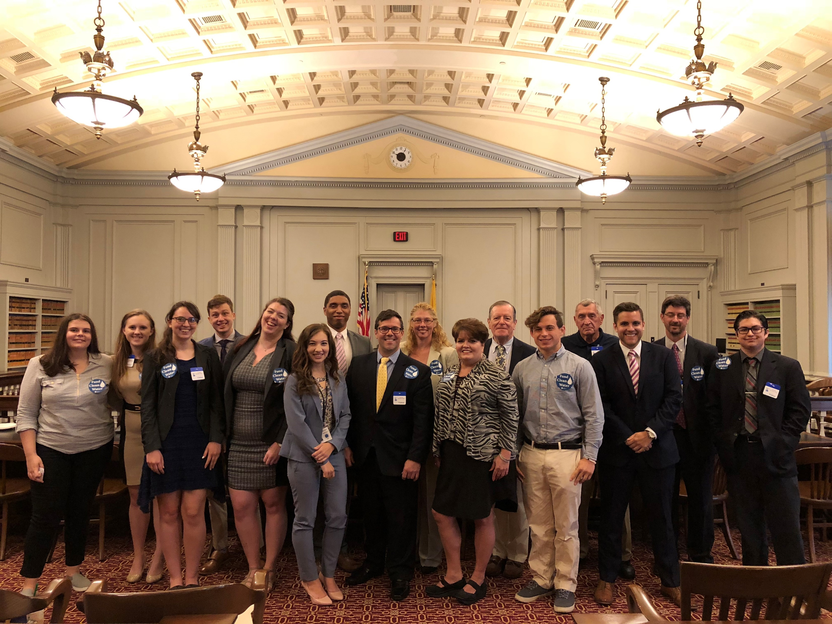
To wrap up..
Put relationships and members first
Develop a single, shared story line or vision
Collaborate to design a framework and structure to get things done
Decide who does what and tackle tasks together, relying on complementary strengths.
Share successes and credit
Notes:
Coalition members must forge good working relationships and trust over time. Having clear decision-making processes and mechanisms to resolve conflicts can help to build trust

Slide 19
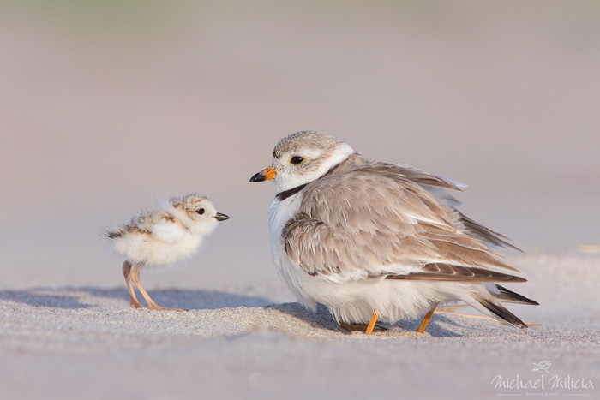
Questions?
Sandra Meola
sandra.meola@njaudubon.org
609-400-3876
www.delriverwatershed.org
Photo credit: Michael Milicia

